Slide 1
genAI & deployment
Teoh Teik Toe
ITOM/NBS
ttteoh@ntu.edu.sg
97905202

Slide 2

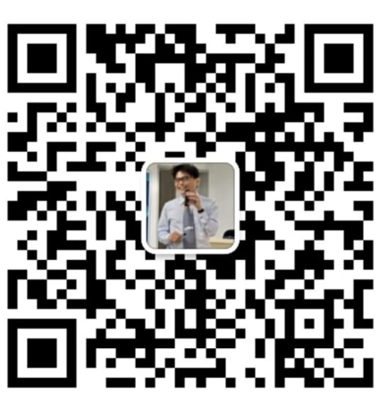

Whatsapp: 65-97905202
Wechat: TeohTeikToe
LinkedIN https://www.linkedin.com/in/teohteiktoe

Slide 3
Agenda
Introduction to GPT
Text 1. api - groq 2. download – deepseek & sealion Deployment 1. web application 2. telegram
Image
Download stable diffusion
Music
https://youtu.be/d_7EsKcn8nw?si=1Uq1FziXUNQ6vuMd
https://youtu.be/eMrKj3goxAM?si=zJ7MdSa1F2P5TvzE
Video GPT
https://youtu.be/yyGGI9WP3qs?si=ugBzu5Ag7vP6sDTV

Slide 4
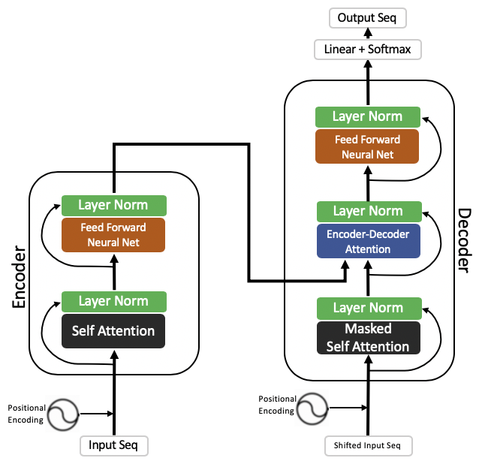
Text - Transformer Large Language Model
How encoder decoder works in Transformer: https://jalammar.github.io/illustrated-transformer/
The transformer is the model, while the attention is a technique used by the model.

Slide 5
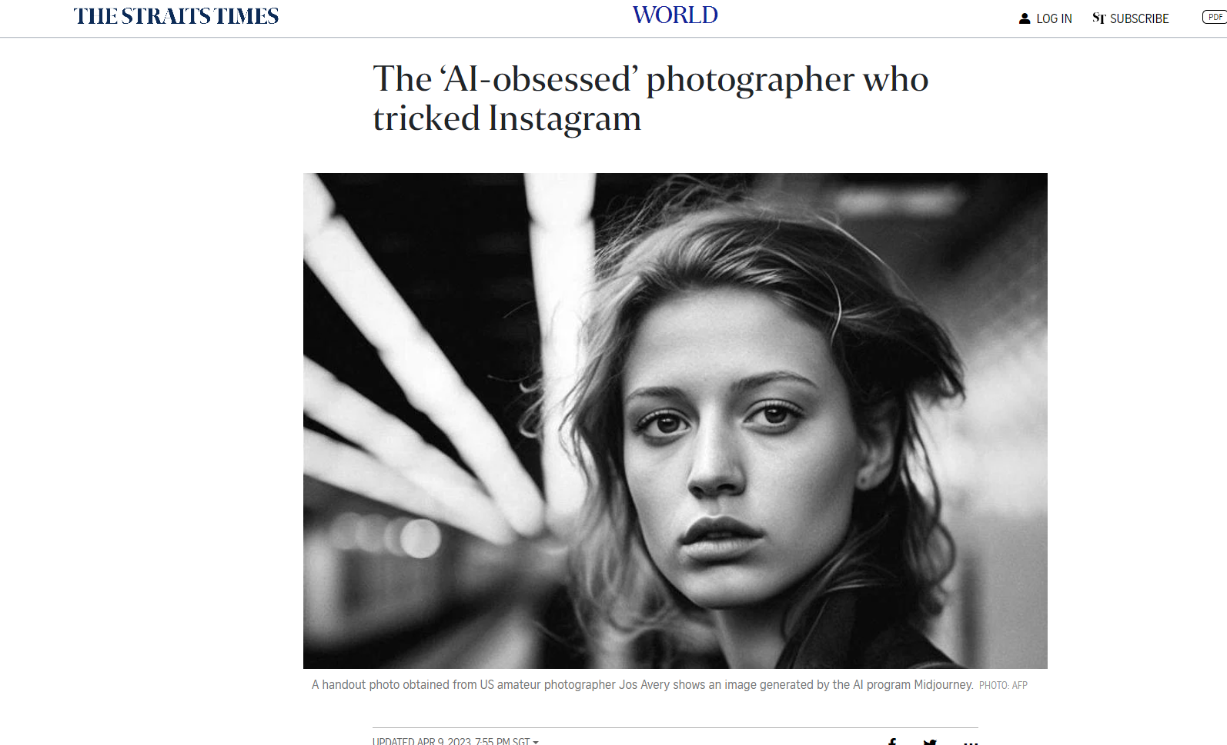
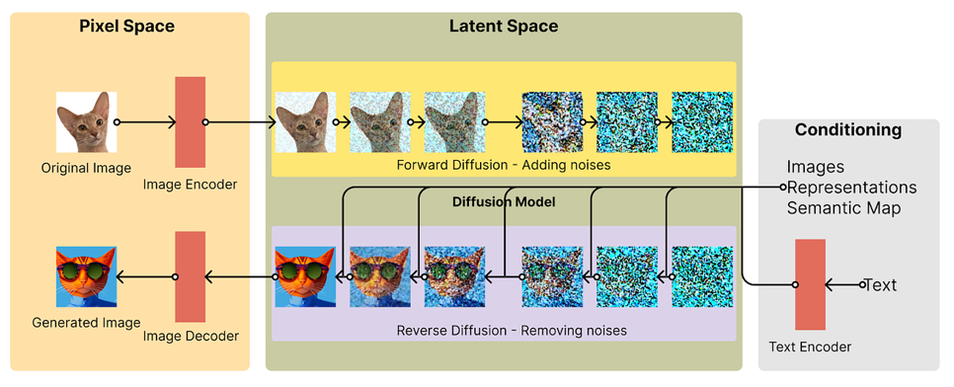
Image/Music/Video Diffusion
https://www.straitstimes.com/world/europe/the-ai-obsessed-photographer-who-tricked-instagram

Slide 6
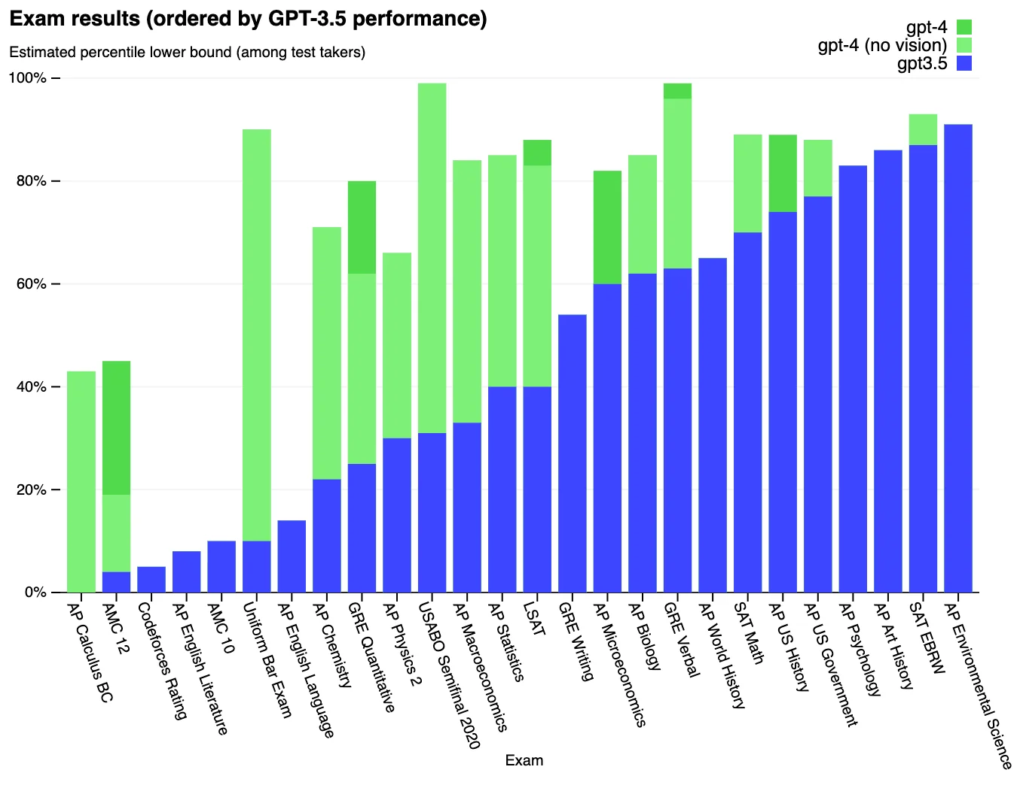
This is only the beginning
https://cdn.openai.com/papers/gpt-4.pdf

Slide 7
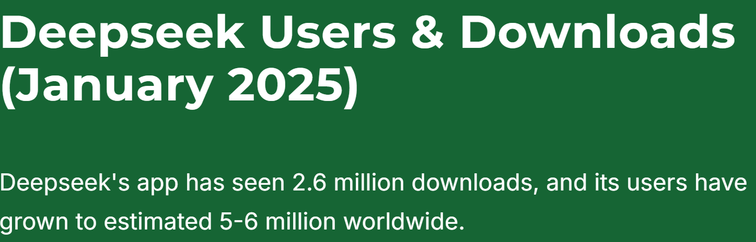
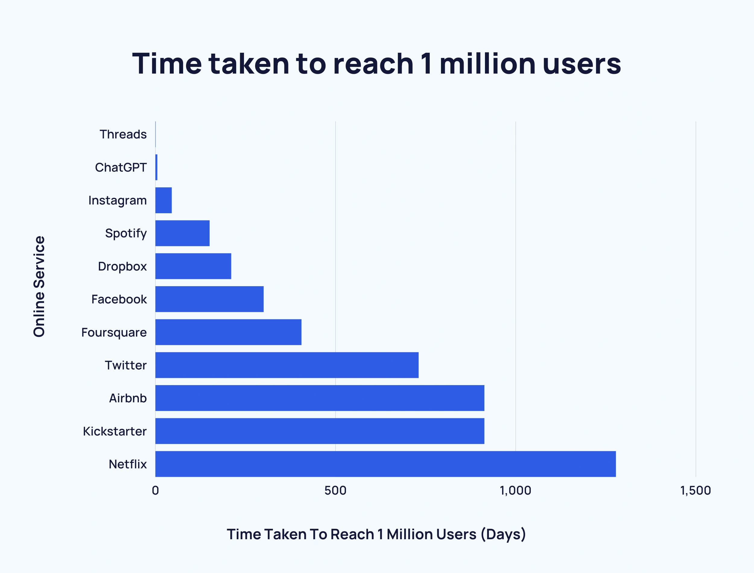
Number of download
15 Jan to 29 Jan: DeepSeek 1.2 million Play Store, 1.9 million App Store. The actual number of Over 5 million Play Store.
https://seo.ai/blog/deepseek-users-downloads

Slide 8
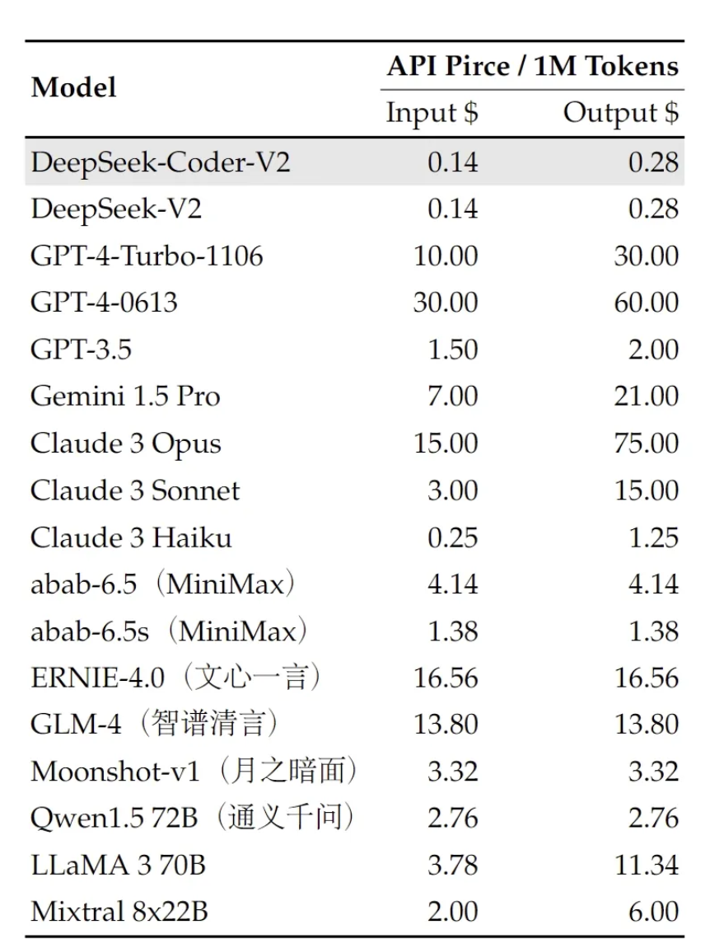
Price Comparison
https://medium.com/chat-gpt-now-writes-all-my-articles/need-a-coding-buddy-use-deepseek-over-chatgpt-faster-better-and-cheaper-ddb9856e6d7b

Slide 9
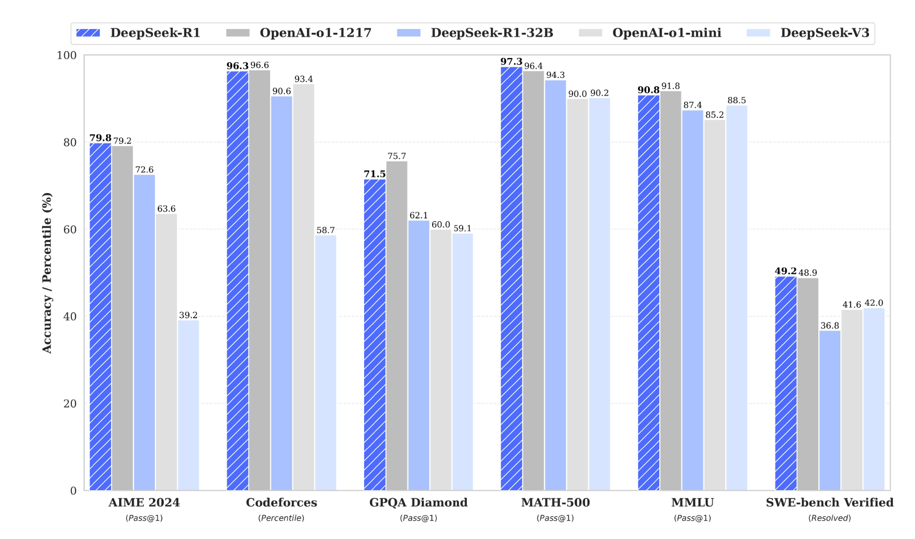
Final Test on Deepseek: https://www.youtube.com/watch?v=P3BKdSKi1VI

Slide 10
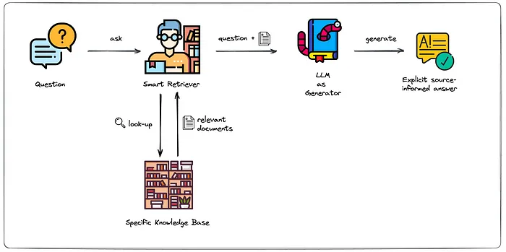
Agentic AI - Retrieval-Augmented Generation (RAG)
https://medium.com/artificial-corner/retrieval-augmented-generation-rag-a-short-introduction-21d0044d65ff

Slide 11
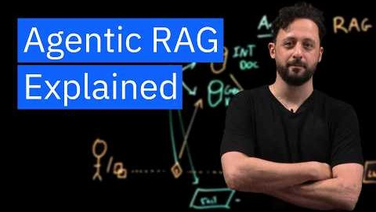
RAG video

Slide 12
Langchain code
https://python.langchain.com/docs/tutorials/retrievers/
Code
https://colab.research.google.com/drive/1vT4NgifeOstkKsv1T3rpIcHT2r0fBSs3?usp=drive_link

Slide 13
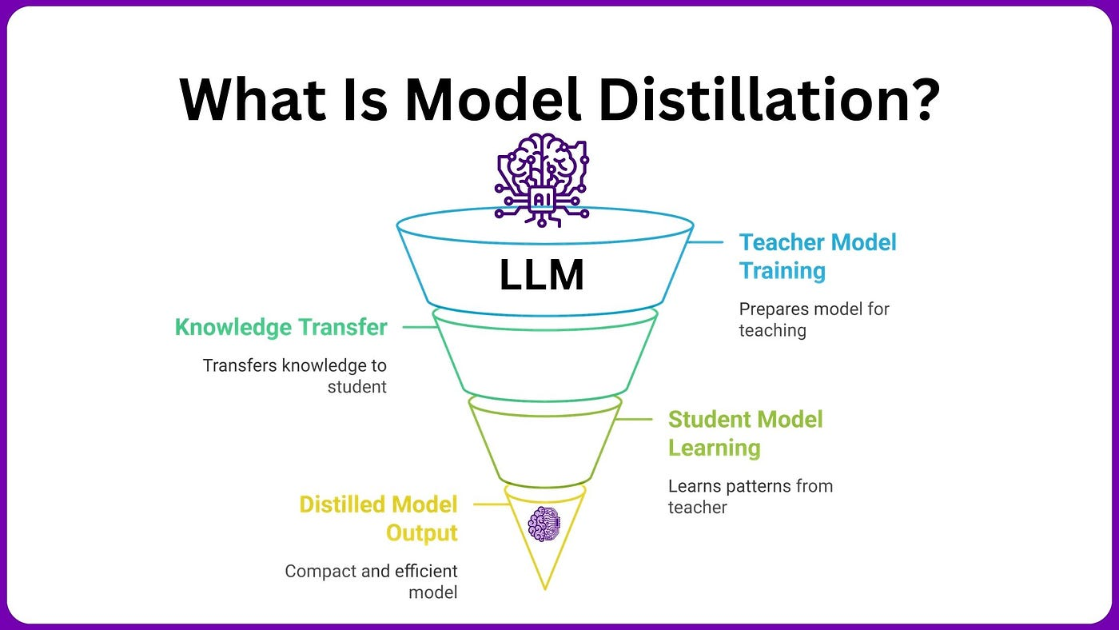
distill

Slide 14
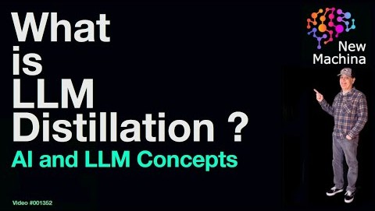
Distill video

Slide 15
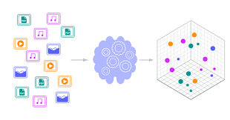
Graph vs Vector Database
https://www.avolutionsoftware.com/abacus/the-graph-database-advantage-for-enterprise-architects/

Slide 16
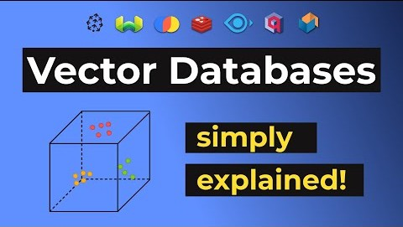
Vector database

Slide 17
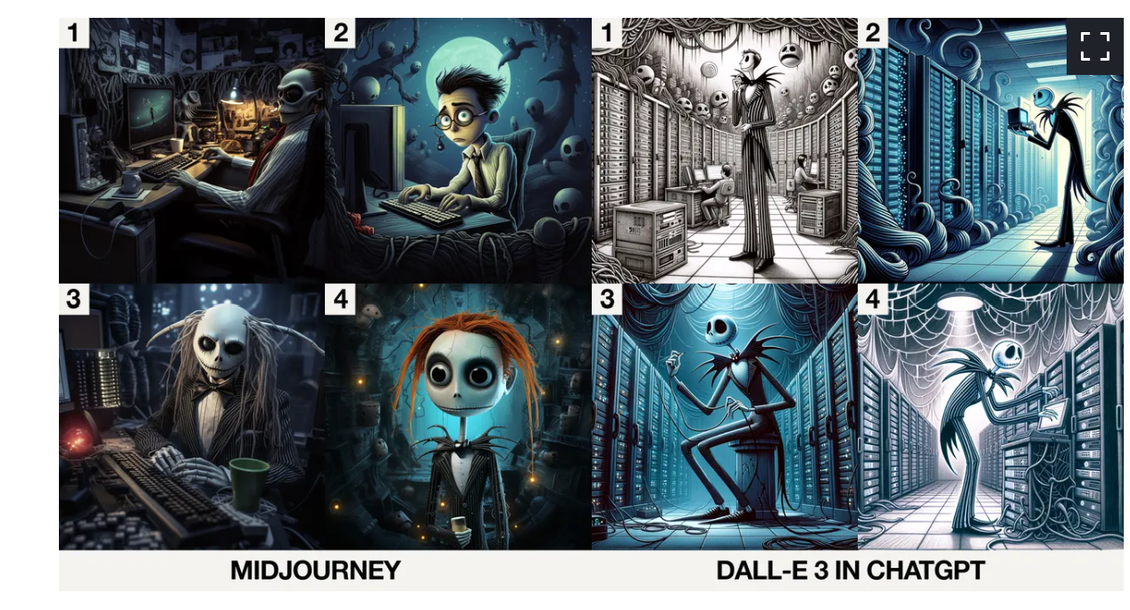
Image – Dalle vs MidJourney
https://www.google.com/amp/s/www.zdnet.com/google-amp/article/midjourney-vs-dall-e-3-in-chatgpt-which-ai-does-halloween-better/

Slide 18
Programming 1. api - groq 2. download – deepseek & sealion Deployment 1. web application 2. telegram

Slide 19
groq
Api : https://console.groq.com/keys
https://console.groq.com/docs/models
!pip install groq
from google.colab import userdata
GROQ_API_KEY = userdata.get('GROQ_API_KEY’)
import os
os.environ['GROQ_API_KEY'] = GROQ_API_KEY
From groq import Groq
client = Groq()
r = client.chat.completions.create(
model = "llama-3.1-8b-instant",
messages=[
{
"role": "user",
"content": "What is the capital of France?"
}
]
)
r.choices[0].message.content
https://colab.research.google.com/drive/1KSQnw0lUNjOirD4ry9Jfoeum9sKU0beC?usp=drive_link
https://console.groq.com/docs/models
aisingapore/Llama-SEA-LION-v3-70B-IT
aisingapore/Gemma-SEA-LION-v4-27B-IT
aisingapore/Qwen-SEA-LION-v4-32B-IT
aisingapore/SEA-Guard
BAAI/bge-m3
aisingapore/Llama-SEA-LION-v3.5-70B-R

Slide 20
groq in gradio
!pip install gradio groq
from google.colab import userdata
import os
#https://console.groq.com/keys
os.environ['GROQ_API_KEY'] = userdata.get('GROQ_API_KEY')
from groq import Groq
client = Groq()
import gradio as gr
from groq import Groq
# Define a simple function
def groq(text):
client = Groq()
completion = client.chat.completions.create(
model="llama-3.1-8b-instant",
messages=[
{
"role": "user",
"content": text
}
]
)
return(completion.choices[0].message.content)
# Create Gradio interface
demo = gr.Interface(
fn=groq, # Function to call
inputs=gr.Textbox(label="Enter text"), # Input component
outputs=gr.Textbox(label="query") # Output component
)
# Launch the interface
demo.launch(debug=True)

Slide 21
Groq in gradio in hugging face
#pip install gradio groq
import os
#https://console.groq.com/keys
import gradio as gr
from groq import Groq
# Define a simple function
def groq(text):
client = Groq()
completion = client.chat.completions.create(
model="llama-3.1-8b-instant",
messages=[
{
"role": "user",
"content": text
}
]
)
return(completion.choices[0].message.content)
# Create Gradio interface
demo = gr.Interface(
fn=groq, # Function to call
inputs=gr.Textbox(label="Enter text"), # Input component
outputs=gr.Textbox(label="Reversed text") # Output component
)
# Launch the interface
demo.launch(debug=True)
Requirements.txt
gradio
groq

Slide 22
Download genAI

Slide 23
deepseek
!curl https://ollama.ai/install.sh | sh
!sudo apt-get update && sudo apt-get install -y cuda-drivers #select 26 for English
import os
os.environ.update({'LD_LIBRARY_PATH': '/usr/lib64-nvidia'})
# start server
!nohup ollama serve &
Desktop cmd:
ollama run deepseek-r1:7b
Code:
https://colab.research.google.com/drive/1pNN-Mb8NSXEoV8X5dxSB6uk5oiVS3WRP?usp=drive_link
!ollama pull deepseek-r1:7b
!pip install ollama
import ollama
response = ollama.chat(model='deepseek-r1:7b', messages=
[
{ 'role': 'user', 'content': "Describe Singapore"}
])
print(response['message']['content'])
Recording:
https://1drv.ms/v/s!Aik2a4x7tvLynJ1ISMzqKIJkpsQdJQ?e=HPbzAC

Slide 24
sealion

Slide 25
Smaller model
https://colab.research.google.com/drive/1el61xq9n4rWkmrq0W5eAIY6_A4E62Edd?usp=drive_link
import torch
from transformers import AutoTokenizer, pipeline
model_id = "TinyLlama/TinyLlama-1.1B-Chat-v1.0" # ← swap to any pick above
tok = AutoTokenizer.from_pretrained(model_id)
pipe = pipeline(
"text-generation",
model=model_id,
tokenizer=tok,
model_kwargs={"torch_dtype": torch.bfloat16}, # use float16/32 if needed
device_map="auto",
)
messages = [{"role": "user", "content": "describe singapore"}]
prompt = tok.apply_chat_template(messages, tokenize=False, add_generation_prompt=True)
out = pipe(prompt, max_new_tokens=256, do_sample=True, temperature=0.7, return_full_text=False)
print(out[0]["generated_text"])
CHANGE TO GPU

Slide 26
import transformers
import torch
model_id = "aisingapore/Llama-SEA-LION-v3.5-8B-R"
pipeline = transformers.pipeline(
"text-generation",
model=model_id,
model_kwargs={"torch_dtype": torch.bfloat16},
device_map="auto",
)
messages = [
{"role": "user", "content": "describe singapore"},
]
outputs = pipeline(
messages,
max_new_tokens=256,
)
print(outputs[0]["generated_text"][-1])
CHANGE TO GPU
print(outputs[0]["generated_text"][-1]["content"])

Slide 27
Image
!pip install gradio diffusers torch accelerate transformers
import torch
from diffusers import StableDiffusionPipeline
pipe = StableDiffusionPipeline.from_pretrained(
"runwayml/stable-diffusion-v1-5",
torch_dtype=torch.float16
).to("cuda")
image = pipe("pug").images[0]
image
image.save("image.png")

Slide 28
Image gradio
! pip install gradio diffusers torch accelerate transformers
import gradio as gr
from diffusers import StableDiffusionPipeline
import torch
# Load the model (ensure you have the correct model name and access)
pipe = StableDiffusionPipeline.from_pretrained(
"runwayml/stable-diffusion-v1-5",
torch_dtype=torch.float16
).to("cuda")
# Define the generation function
def generate_image(prompt):
image = pipe(prompt).images[0]
return image
# Gradio interface
gr.Interface(
fn=generate_image,
inputs=gr.Textbox(label="Enter a prompt"),
outputs=gr.Image(label="Generated Image"),
title="Text to Image Generator"
).launch()

Slide 29
Save model
import torch
from transformers import AutoTokenizer, pipeline
model_id = "TinyLlama/TinyLlama-1.1B-Chat-v1.0" # ← swap to any pick above
tok = AutoTokenizer.from_pretrained(model_id)
pipe = pipeline(
"text-generation",
model=model_id,
tokenizer=tok,
model_kwargs={"torch_dtype": torch.bfloat16}, # use float16/32 if needed
device_map="auto",
)
messages = [{"role": "user", "content": "describe singapore"}]
prompt = tok.apply_chat_template(messages, tokenize=False, add_generation_prompt=True)
out = pipe(prompt, max_new_tokens=256, do_sample=True, temperature=0.7, return_full_text=False)
print(out[0]["generated_text"])

Slide 30
Load model
from transformers import AutoTokenizer, AutoModelForCausalLM, pipeline
import torch
path = "/content/drive/MyDrive/hf/hub/models--TinyLlama--TinyLlama-1.1B-Chat-v1.0/snapshots/fe8a4ea1ffedaf415f4da2f062534de366a451e6"
tok = AutoTokenizer.from_pretrained(path, local_files_only=True)
model = AutoModelForCausalLM.from_pretrained(
path,
torch_dtype=torch.bfloat16,
device_map="auto",
local_files_only=True
)
pipe = pipeline("text-generation", model=model, tokenizer=tok)
print(pipe("Describe Singapore.", max_new_tokens=256)[0]["generated_text"])

